Slide 1
FLIGHT PRICE PREDICTION

Slide 2
PROBLEM STATEMENT:
Anyone who has booked a flight ticket knows how unexpectedly the prices vary. The cheapest available ticket on a given flight gets more and less expensive over time. This usually happens as an attempt to maximize revenue based on -
1. Time of purchase patterns (making sure last-minute purchases are expensive)
2. Keeping the flight as full as they want it (raising prices on a flight which is filling up in order to reduce sales and hold back inventory for those expensive last-minute expensive purchases)
So, you have to work on a project where you collect data of flight fares with other features and work to make a model to predict fares of flights.

Slide 3
Business Goal:
After collecting the data, you need to build a machine learning model. Before model building do all data pre-processing steps. Try different models with different hyper parameters and select the best model.
Follow the complete life cycle of data science. Include all the steps like
1. Data Cleaning
2. Exploratory Data Analysis
3. Data Pre-processing
4. Model Building
5. Model Evaluation
6. Selecting the best model

Slide 4
Technical Requirements:
Data needs to be collected from online used flight booking online portals.
If Data contains Null values. You need to treat them using the domain knowledge and your own understanding
Extensive EDA has to be performed to gain relationships of important variable and price.
Data contains numerical as well as categorical variable. You need to handle them accordingly.
You have to build Machine Learning models, apply regularization and determine the optimal values of Hyper Parameters.
You need to find important features which affect the price positively or negatively.

Slide 5
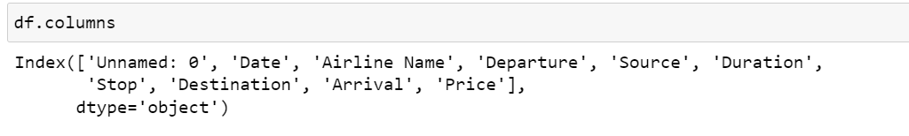
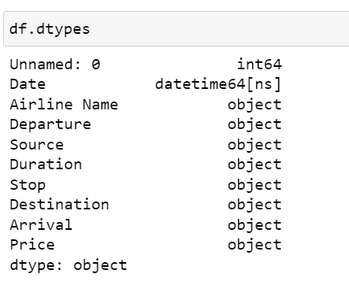
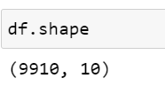
ABOUT THE DATASET:
Using various methods like df.shape, df.columns, df.head(), df.tail() , df.info() to get some idea about the data we are handling

Slide 6
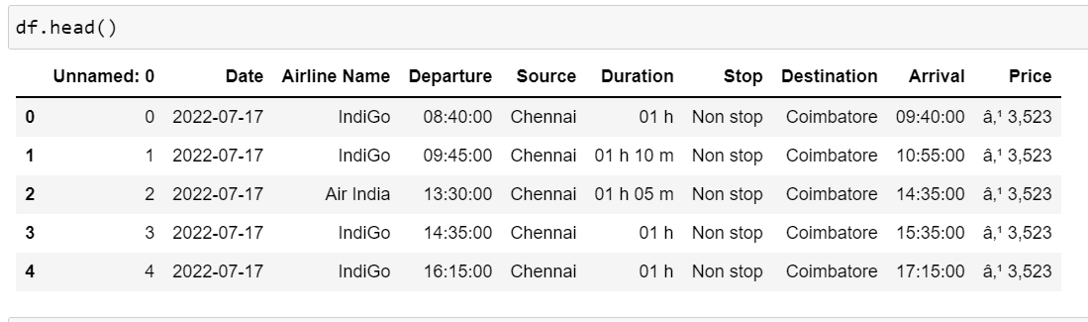
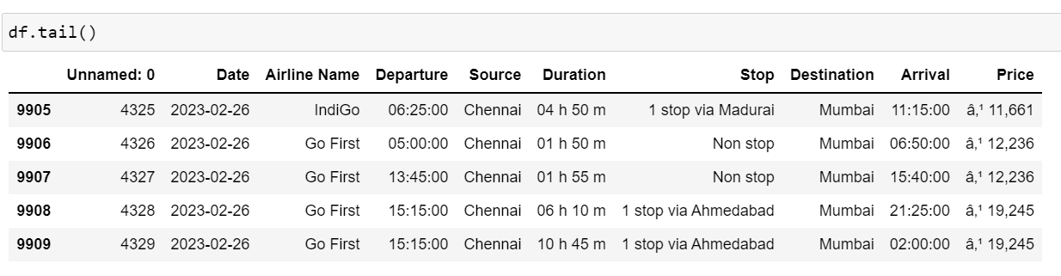
ABOUT THE DATASET:

Slide 7
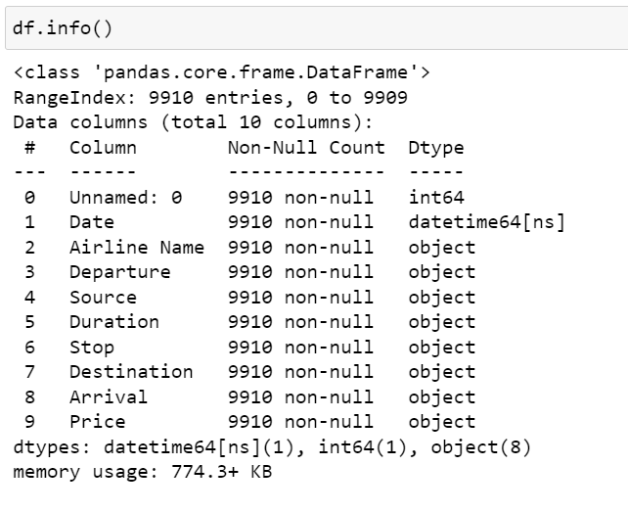
ABOUT THE DATASET:

Slide 8
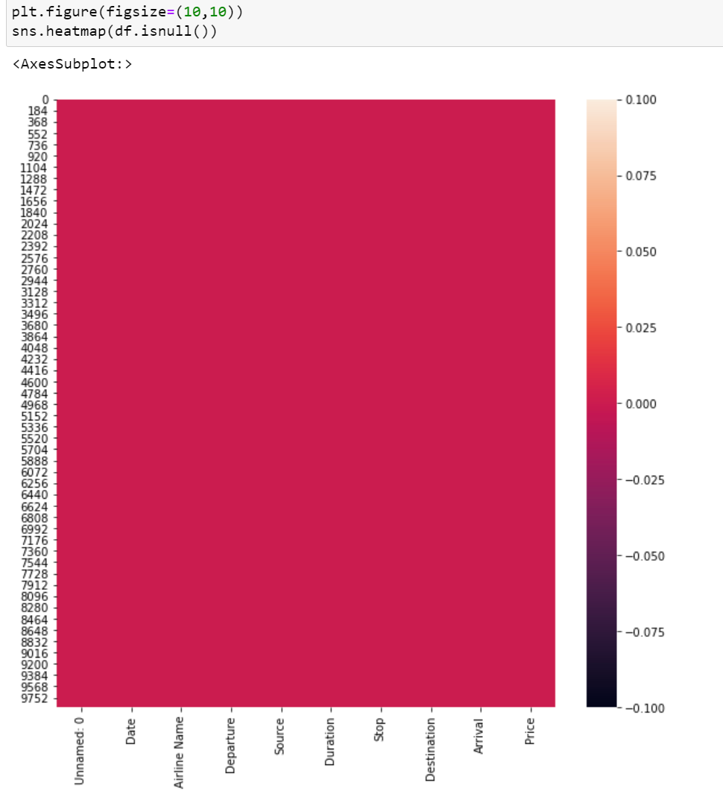
NULL VALUE CHECK:
Checking null values present in data by heatmap.
No null values are present

Slide 9

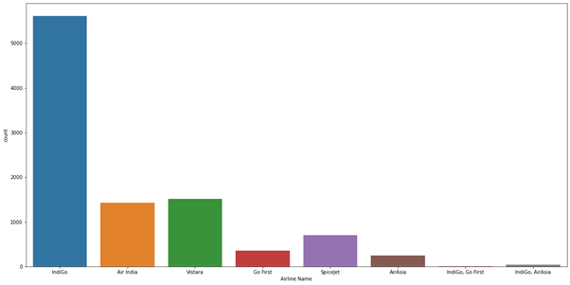
UNIVARIATE ANALYSIS:
Observation:
IndiGo seems to have more frequent flights compared to other airlines

Slide 10

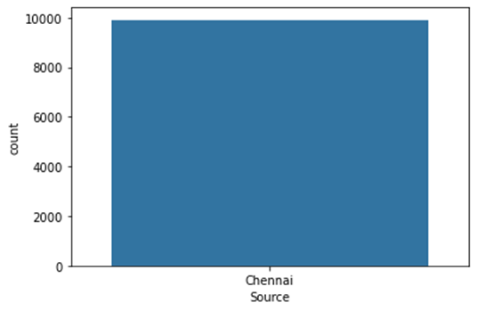
UNIVARIATE ANALYSIS:
Observation:
This Data Set Contains Flights Starting From Chennai

Slide 11

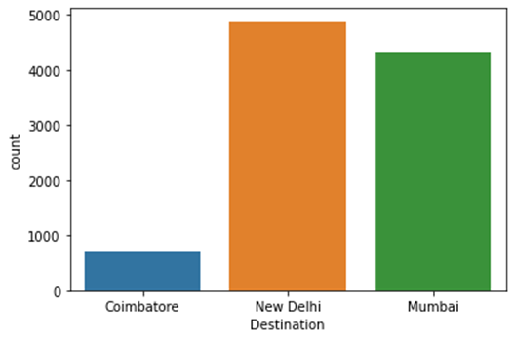
UNIVARIATE ANALYSIS:
Observation:
This Dataset contains Flights Going to Coimbatore New Delhi and Mumbai.
The Flights Going to New Delhi is higher compared to other Two Destinations

Slide 12

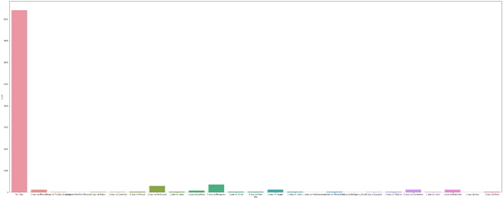
BNIVARIATE ANALYSIS:
Observation:
This No stop flights are higher in number compared to others

Slide 13


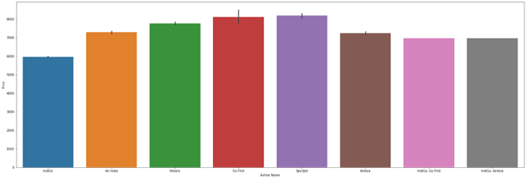
BNIVARIATE ANALYSIS:

Slide 14
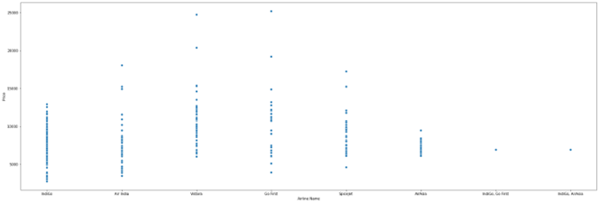
BIVARIATE ANALYSIS:
Observation:
The Price of Indigo is low compared to all other airlines.

Slide 15

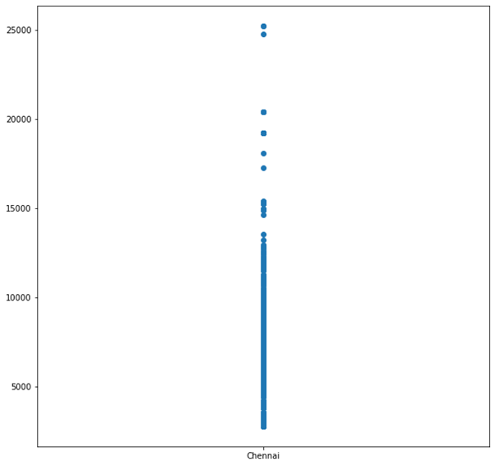
BIVARIATE ANALYSIS:
Observation:
The Price of Flights from Chennai to 3 Destinations are below Rs 5000 to Rs 25,000

Slide 16

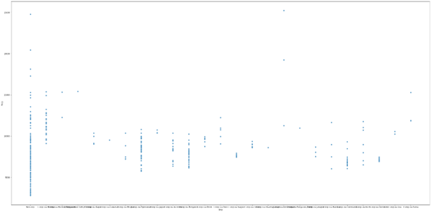
BIVARIATE ANALYSIS:

Slide 17
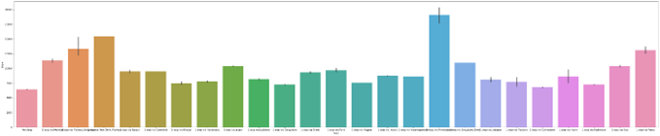
BIVARIATE ANALYSIS:
Observation:
For No Stop flight the Price is Lower. as the stop increases the price also increases
.

Slide 18


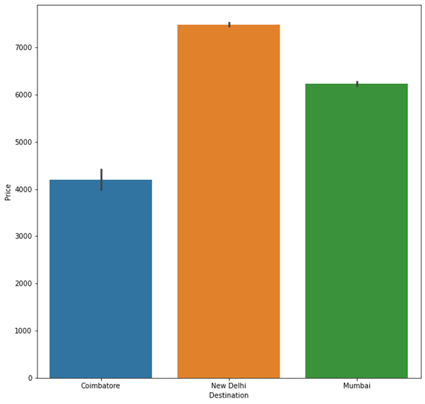
BIVARIATE ANALYSIS:

Slide 19
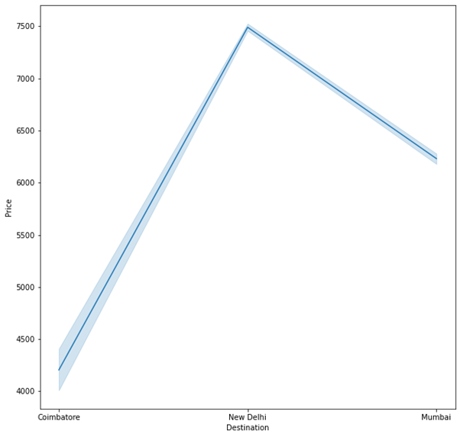
BIVARIATE ANALYSIS:
Observation:
Flights arrival at New Delhi is higher price compared to others

Slide 20

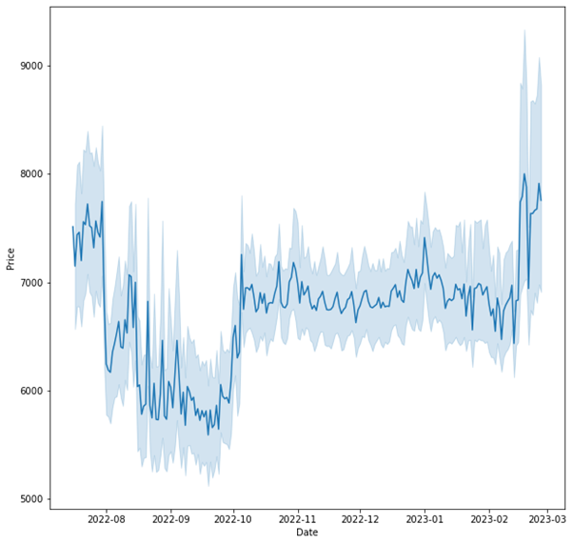
BIVARIATE ANALYSIS:

Slide 21
BIVARIATE ANALYSIS:
Observation:
The Price of Flight Increases when booked at last minute. the price of flight is low when booked 2 to 3 months before in advance. Interestingly the price is higher when booked too advance also we can see the graph when booked 4-5 months in advance the price is high and price is so high when booked at 7 to 8 months in Early.

Slide 22


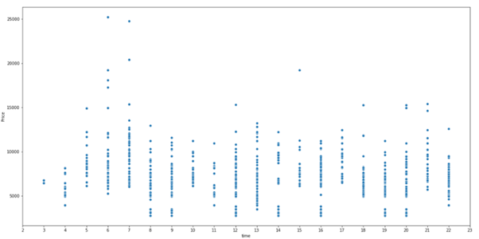
BIVARIATE ANALYSIS:

Slide 23
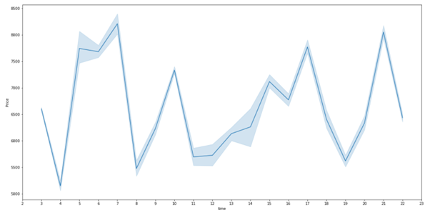
BIVARIATE ANALYSIS:
Observation:
The Price of Ticket is lower for very early morning and late-Night flights before 4.00AM and after 10.00PM.

Slide 24
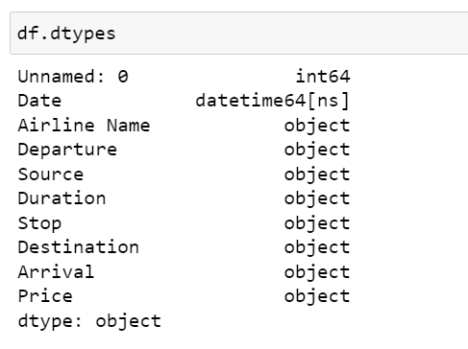
ENCODING
DATA CONTAINS OBJECT DATA SO WE ARE ENCODING WITH DUMMIES METHOD AS DATA HAS NO ORDINAL RELATIONSHIP

Slide 25
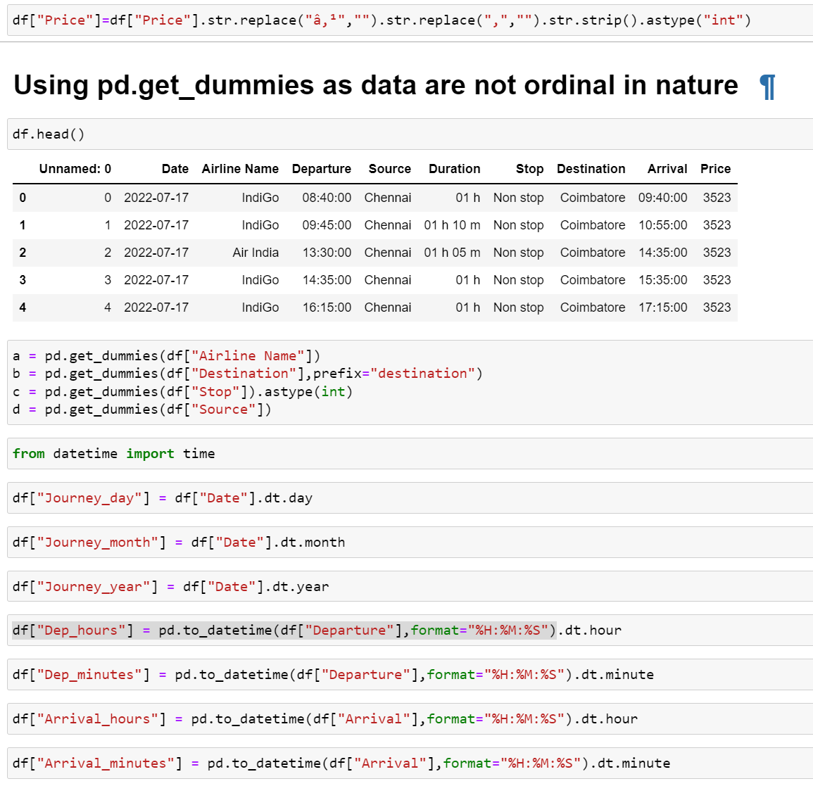
ENCODING:

Slide 26
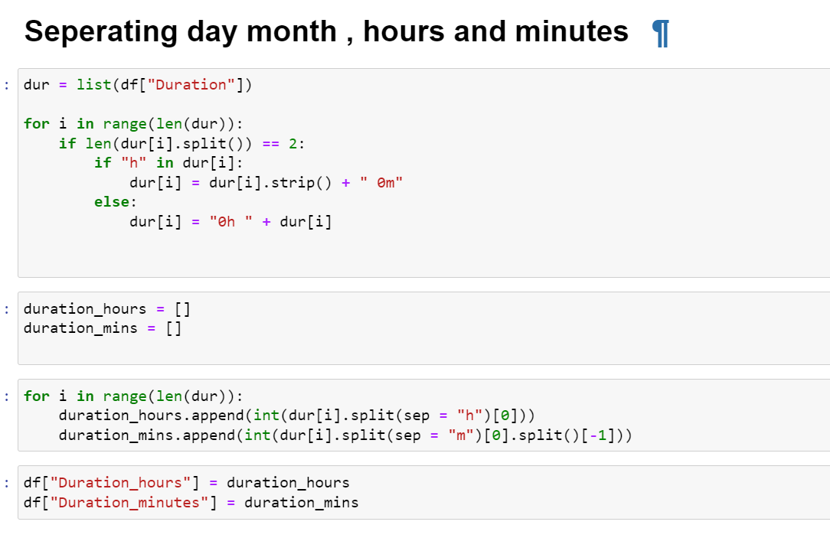
ENCODING:

Slide 27
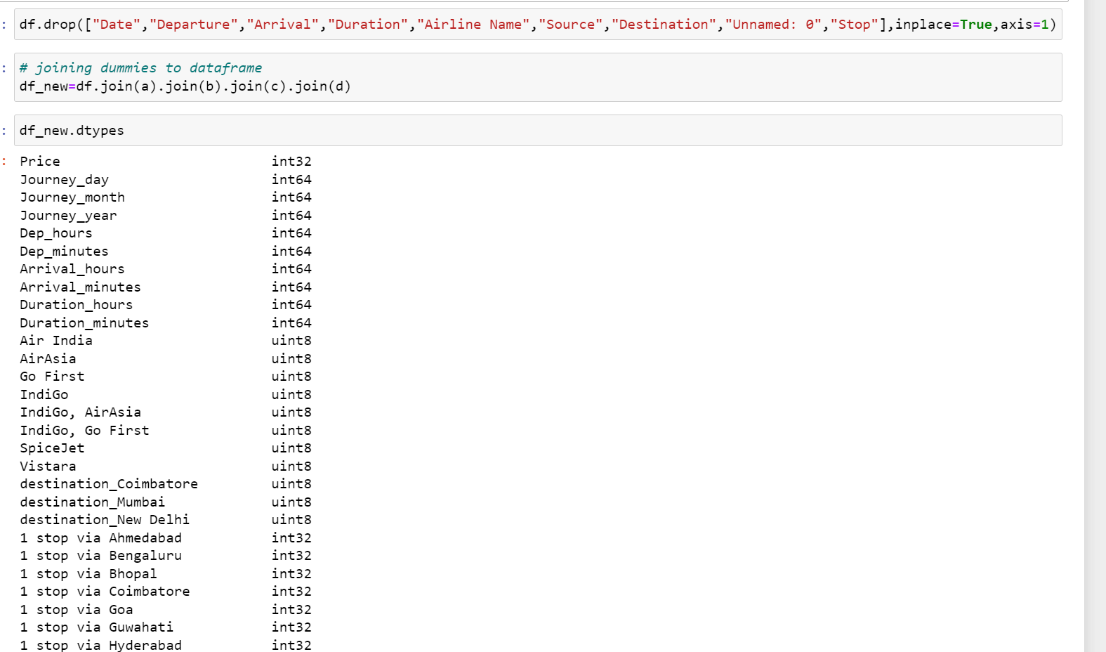
Creating categorical dataframe for pd.get dummies we created earlier

Slide 28
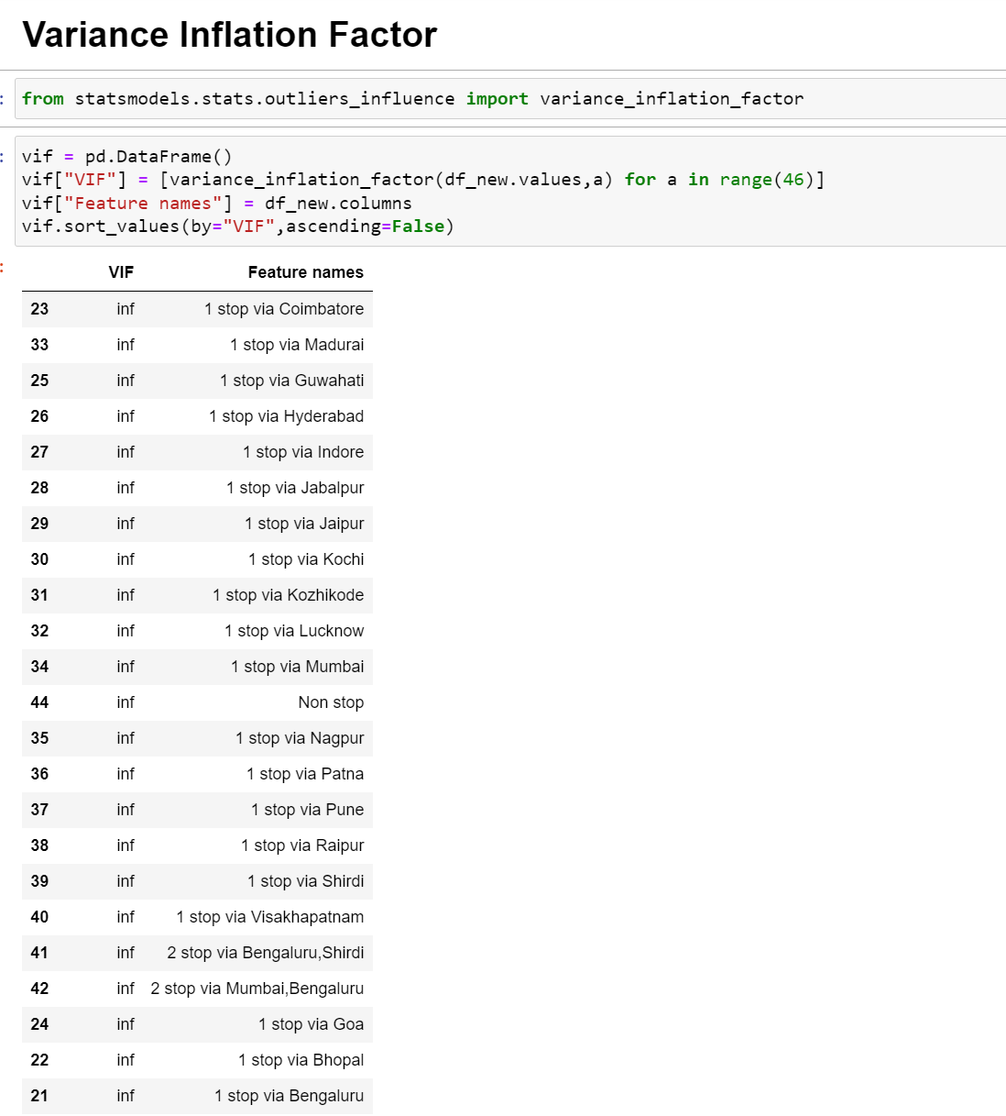
Multicollinearity is so high in this data so we are using PCA and combining them to remove multicollinearity

Slide 29
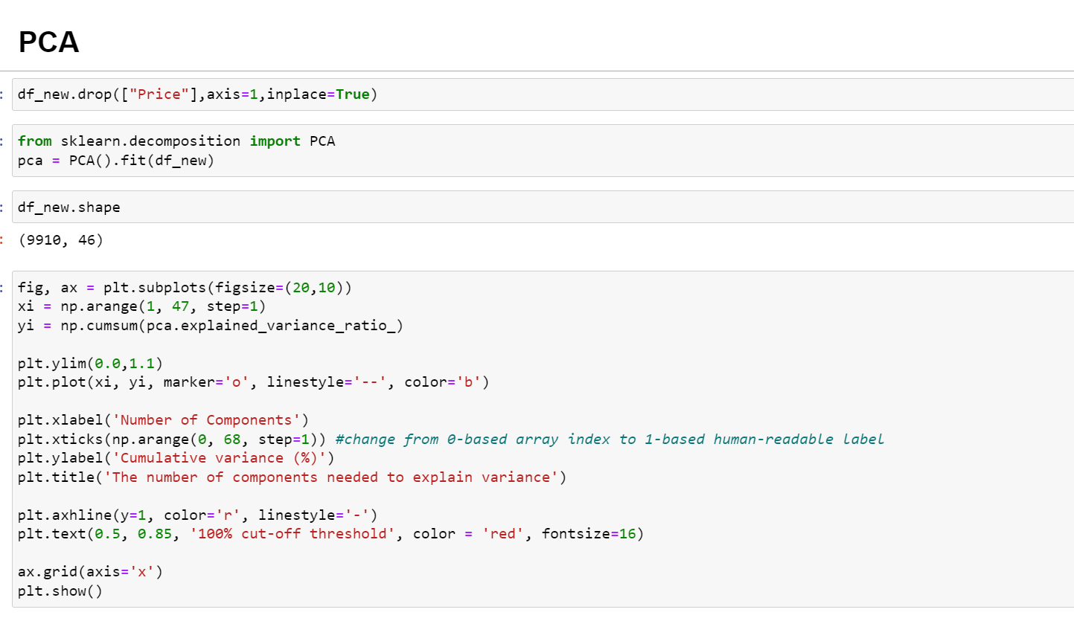

Slide 30
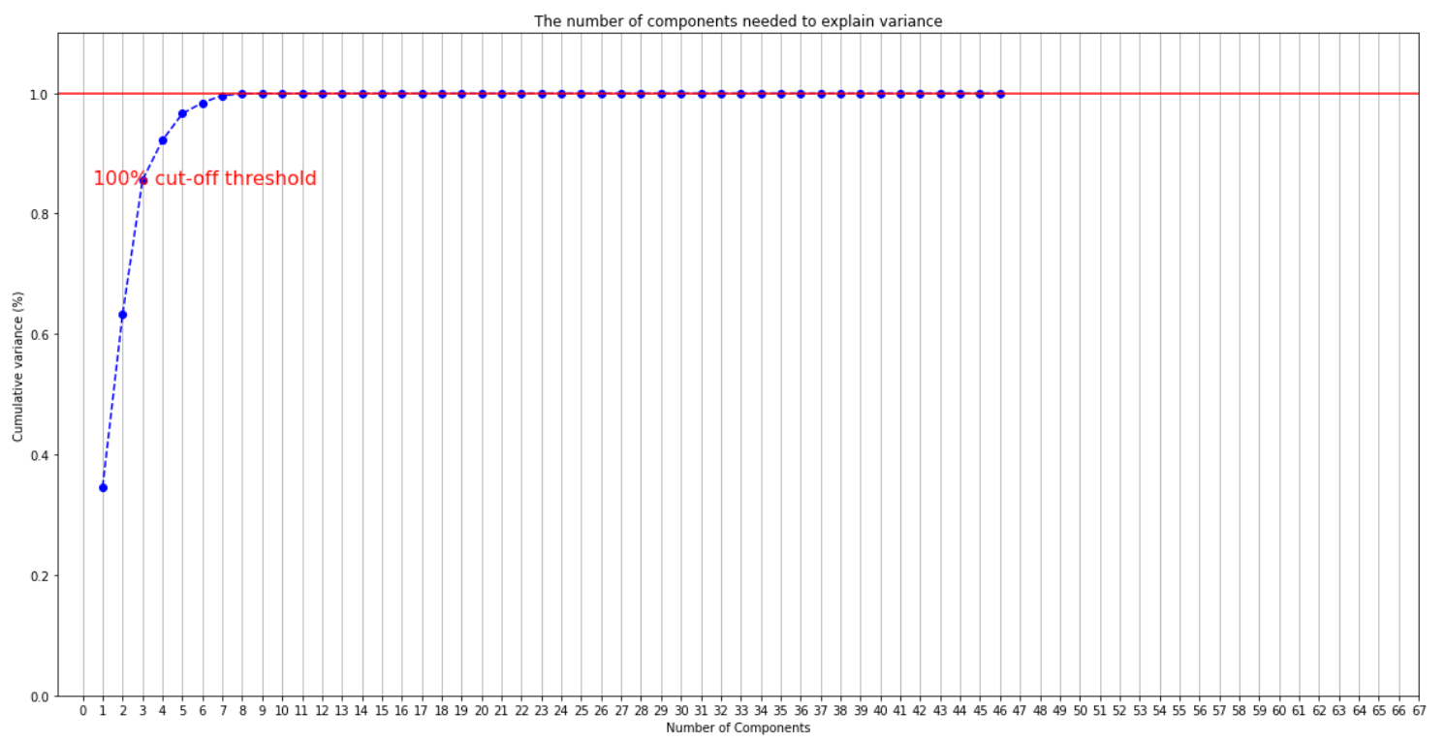

Slide 31
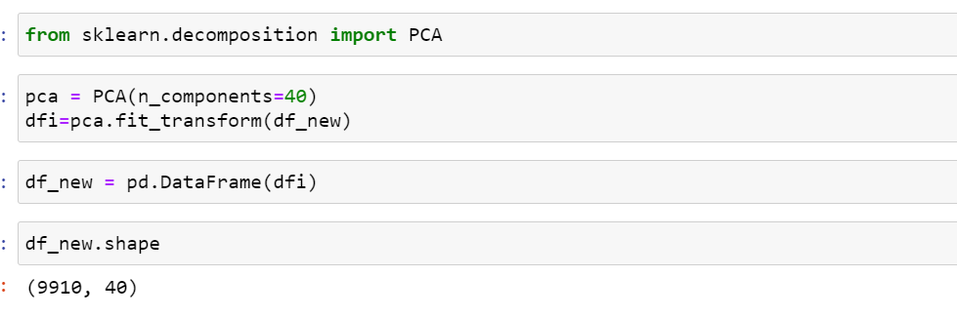
Multicollinearity is so high in this data so we are using PCA and combining them to remove multicollinearity
In graph we can see. We only need 10 columns to retain all information. But we are using 40 columns just to be sure.

Slide 32
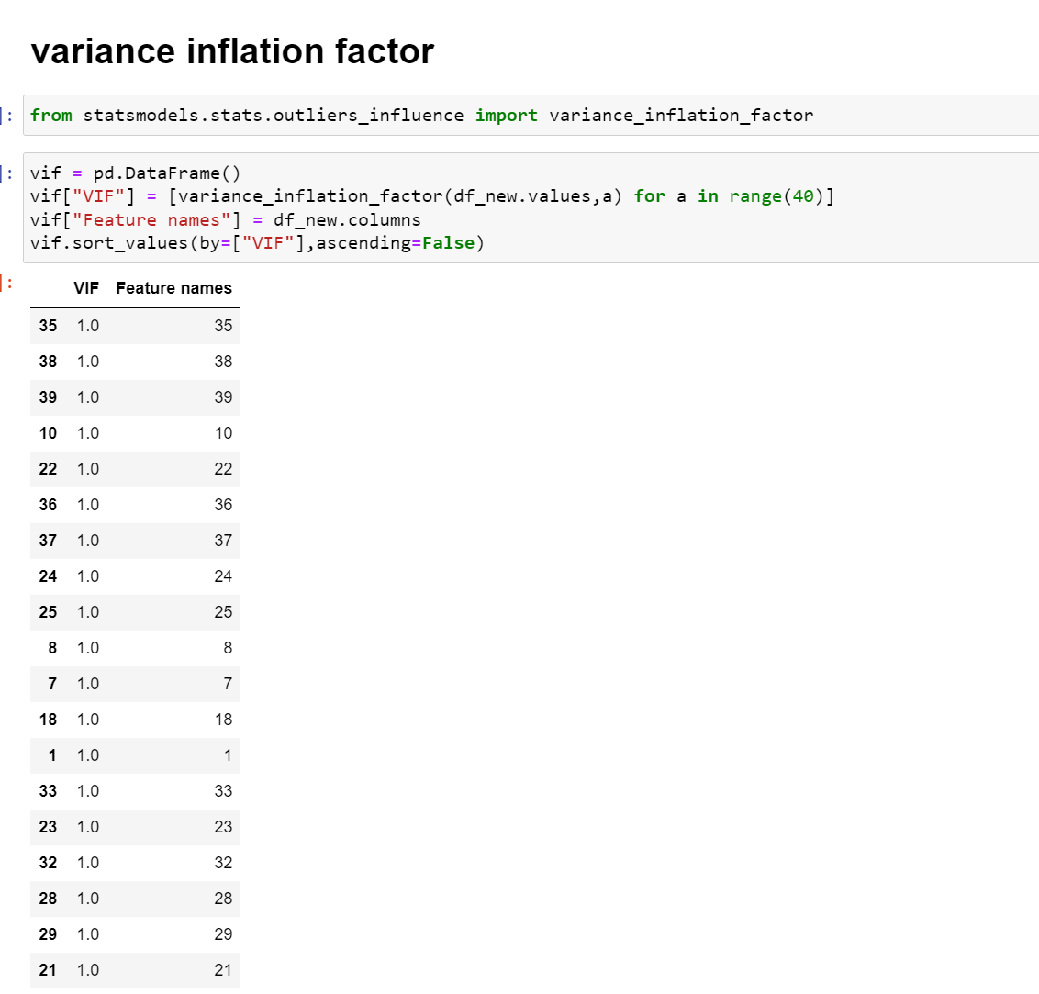
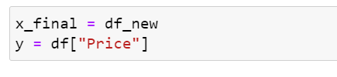
We can see Our Multicollinearity is solved by PCA

Slide 33
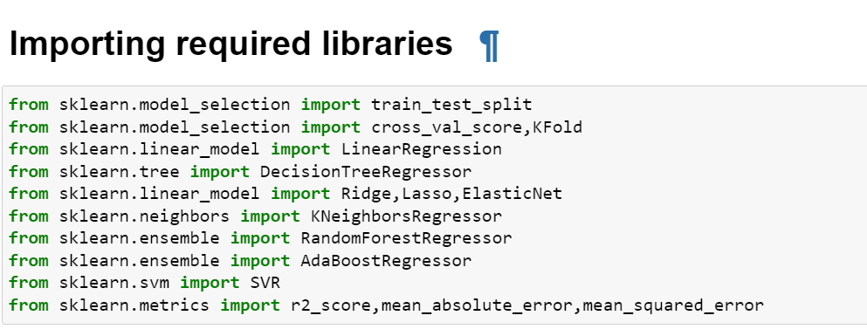
MODEL TRAINING

Slide 34
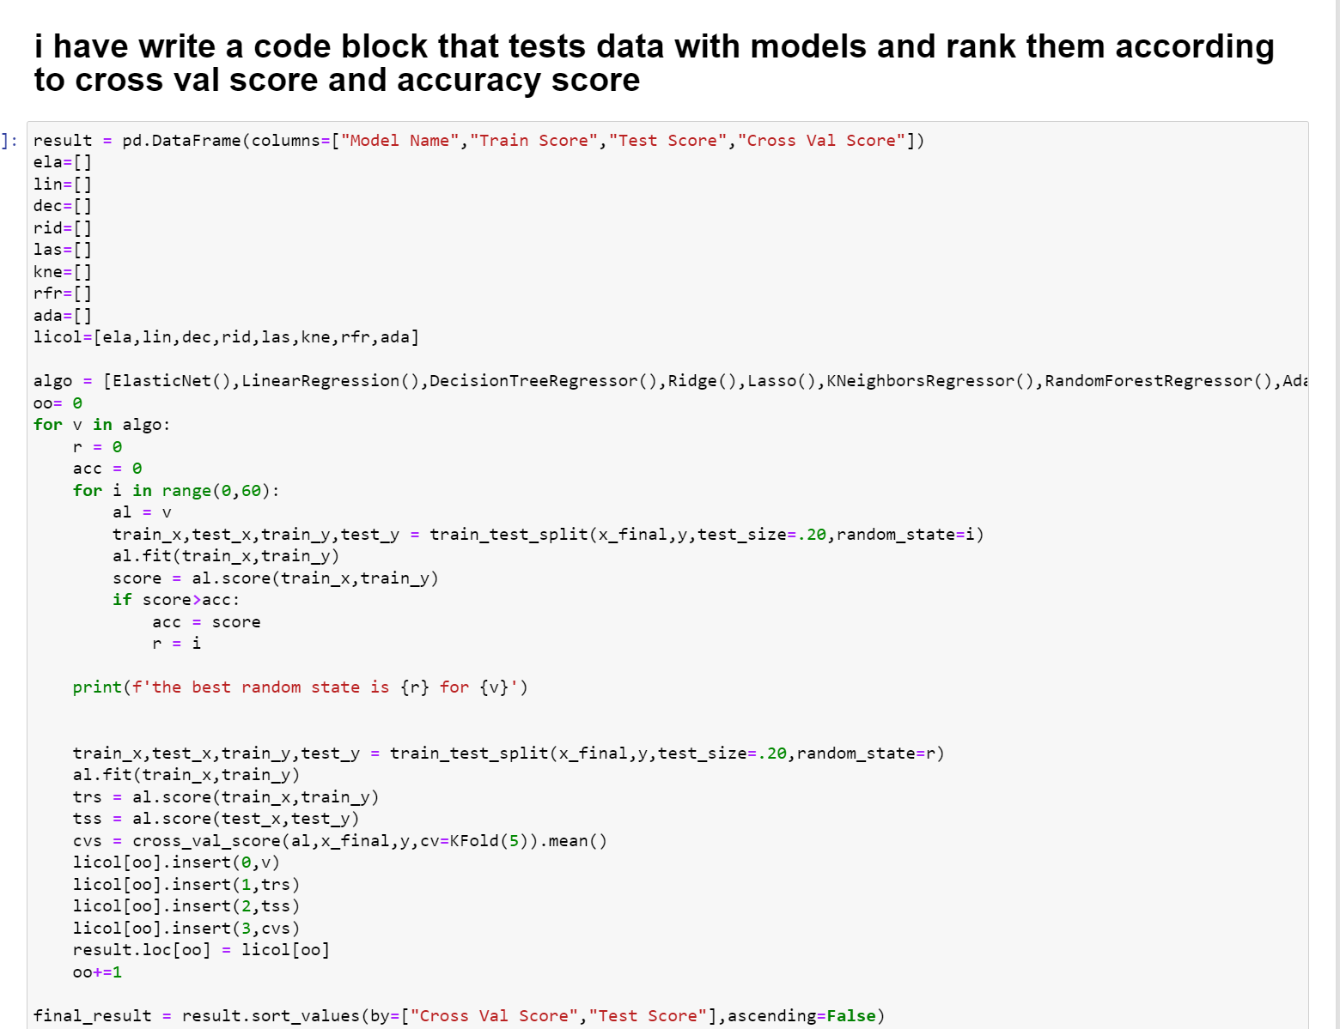
MODEL TRAINING

Slide 35
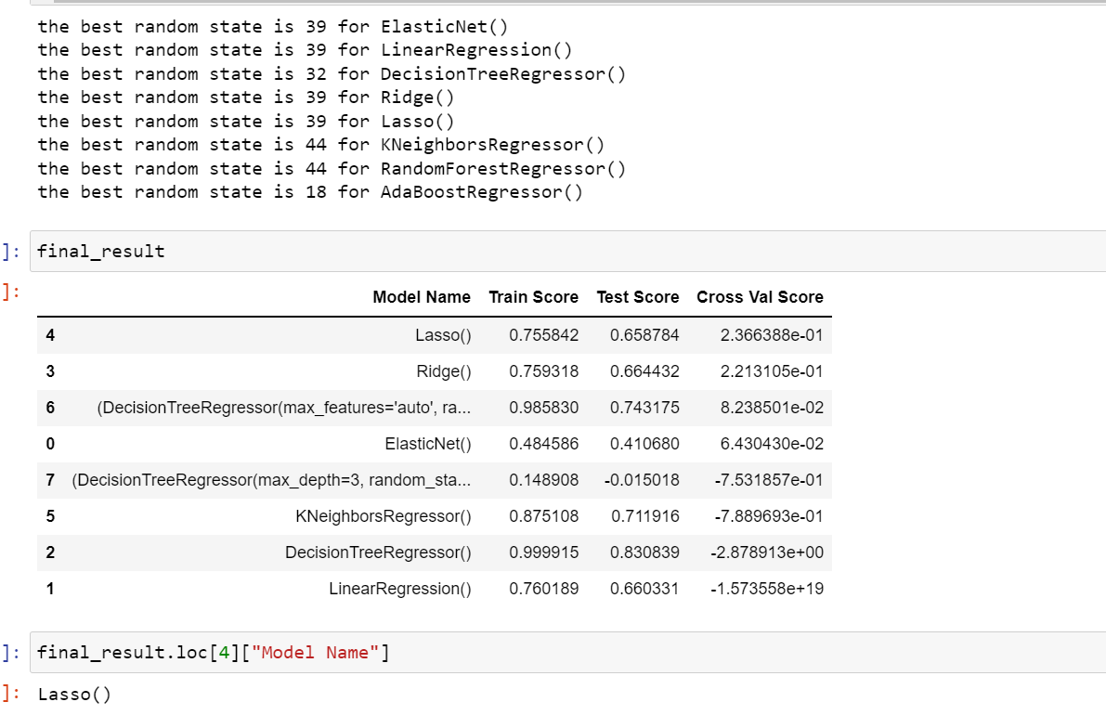
MODEL TRAINING
We can see Lasso performed best compared to other algorithms

Slide 36
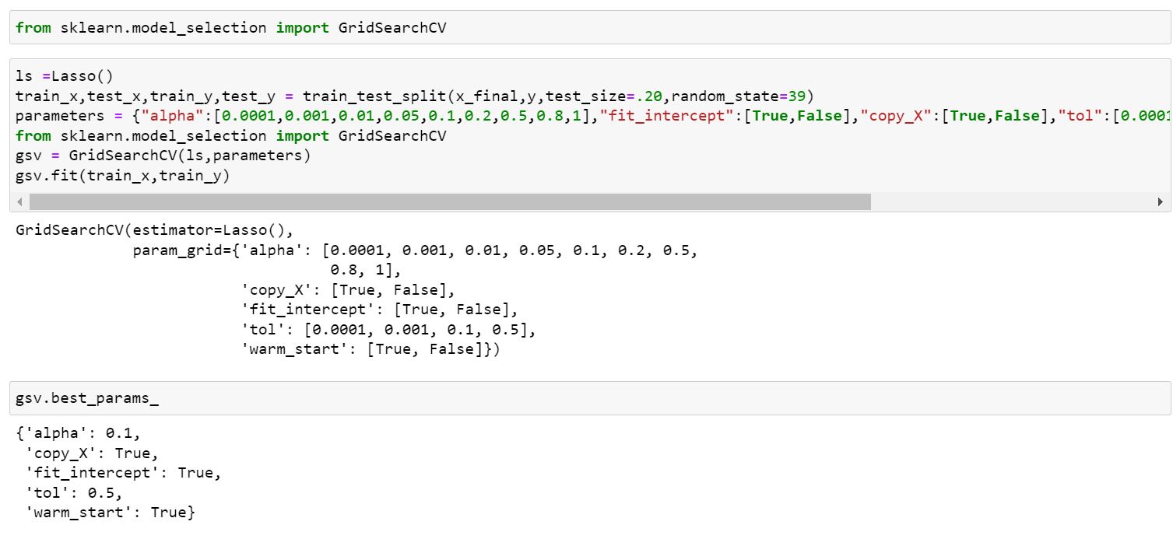
HYPERPARAMETER TUNING

Slide 37
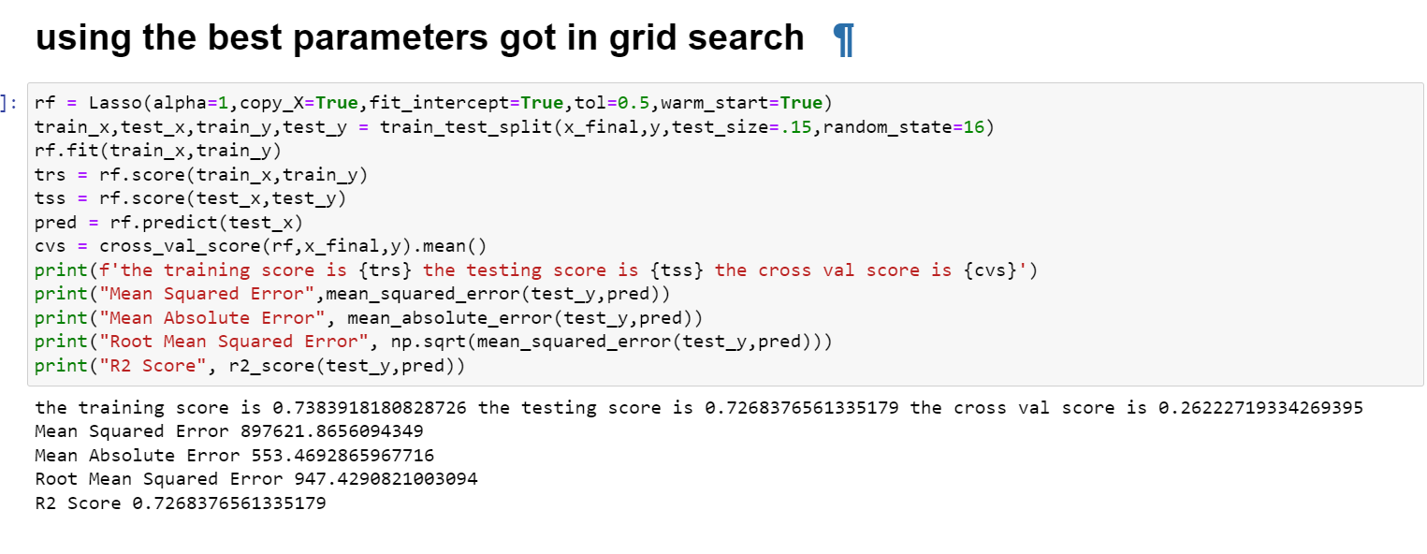
HYPERPARAMETER TUNING

Slide 38
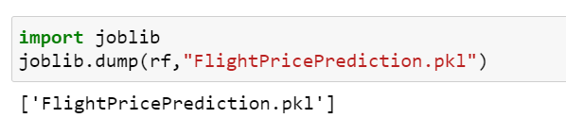
SAVING THE MODEL

Slide 39
CONCLUSION
Key Findings and Conclusions of the Study
Price of Flights when booked at last minute are so high. when flights booked at advance of 2-3 months the price is low. so, the best time to book flight is in advance to 2 to 3 months. The flights without Stops price are less so it is advisable to book flights without stops. Very early morning flights are cheap before 4.00AM or after 10.00PM. Indigo Flight is cheap compared to other Airlines.
Learning Outcomes of the Study in respect of Data Science
When flights booked at advance at 2-3 months the price is low. last minute flight fares are nearly 35% higher compared to advance booking price at 2-3 months. also, when booking too early before 4-8 months the price is 20% higher compared to advance booking at 2-3 months. interestingly when booking at 10 - 12 months in advance the price is higher up to 35%. so, the best time to book flight is in advance to 2 to 3 months.
Limitations of this work and Scope for Future Work
The Data Collected is not diversified across all places in India. So in depth analysis can be done after collecting data across India.

Slide 40
THANK YOU FOR THE OPPORTUNITY

